Slide 1


General Biology lab
Al-Karkh University for Science
Collage of Science
Microbiology Department
Dr. Rawa Abdul Redha Aziz
Ph.D Antibiotics/ Molecular biology
Laboratory Staff:
1. Lecturer Dr. Rawa Abdul Redha Aziz
2. L. assistant Sura Alaa Saud
3. L. assistant Gada Readh
Supervised by:
1. Prof. Munira Ch. Ismaeel
2. Ass. Prof. Israa AJ Ibrahim

Slide 2
Lab 12: Helminthes

Slide 3
The helminths are worm-like parasites. The clinically relevant groups are separated according to their general external shape and the host organ they inhabit. There are both hermaphroditic and bisexual species.
The definitive classification is based on the external and internal morphology of egg, larval, and adult stages.

Slide 4
Classification of helminthes depends on size, shape, organ development, presence of hooks, suckers, or other special structures, mode of reproduction, hosts and appearance of eggs and larvae. The identification of helminthes is usually done by observing adult worm, larvae, or egg under microscope.

Slide 5
In this lab we will study some of the classes related to this worm-like parasites
1. Trematodes
It belongs to the Phylum Platyhelminthes. Trematodes are flatworms and generally have: flattened bodies, a blind alimentary tract, suckers for attachment to their hosts, are hermaphrodites.
The Class Trematoda historically was split into two subclasses:
a. Monogenea, which includes important ectoparasites of fish, and
b. Digenea, including species parasitic in the bile ducts, alimentary and respiratory tracts, and blood vessels of vertebrates.
As the Monogeans and the Digeneans shared many features, we will examine both in this lab.

Slide 6
Subclass: Monogenea
The Monogeans are primarily ectoparasites of aquatic cold-blooded vertebrates, especially fish. Some species, however, are found in the bladder of turtles and frogs.
All are monoecious and the life cycle is direct. They characteristically produce few eggs. In each egg a ciliated larva, the oncomiracidium, develops, hatches, and swims about to attach to a host. The entire cycle may be completed on a single host.
The opisthohaptor (haptor) is very important in the systematics of this group and may be a single adhesive structure equipped with hooks, or it may be divided into a number of individual suckers.

Slide 7
Dactylogyrus extensus Entobdella hippoglossi

Slide 8
Subclass: Digenea
Digenetic trematodes comprise most of the known trematodes and include those of greatest economic importance.
This group is generally referred to as the flukes and is endoparasitic in all classes of vertebrates. Flukes are typically hermaphroditic, but some members are dioecious.
All have complicated life cycles involving two to four different hosts and several different larval stages, with the first ciliated stage being referred to as a miracidium.
Suckers are less well developed than in the Monogenea, but typically two are present, an anterior oral sucker and a ventral sucker (the acetabulum).

Slide 9
Larval Stages of Digenetic Trematodes
Miracidia
Cercariae
Sporocyst
Metacercariae
Rediae
Metacercariae

Slide 10
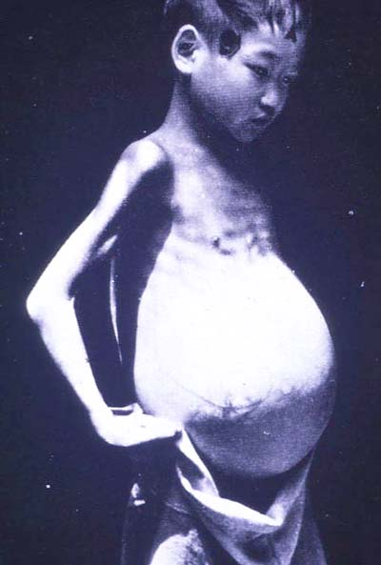
Family Schistosomatidae
Genus: Schistosoma mansoni is a parasite of the mesenteric veins surrounding the intestine of humans in Africa, South America, and Puerto Rico.
- S. mansoni male: the oral sucker, acetabulum, gynaecophoric canal, and 6-9 testes in the male.
- S. mansoni female: the ovary in the anterior half of the female. Note the absence of a pharynx and the characteristics of the gut.
Slide:
Eggs of S. mansoni have a prominent lateral spine, which is diagnostic for this species

Slide 11
Life Cycle:

Slide 12
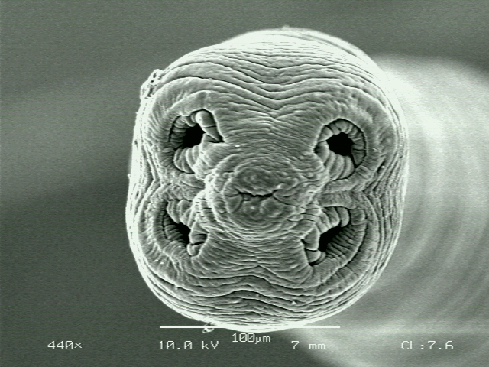
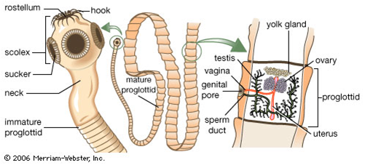
2. Cestodes
Tapeworms (Class Cestoda) are all endoparasitic in nearly every species of vertebrate. This adaptation to parasitism has resulted in the complete loss of the intestine, with only a vestigial oral sucker and pharynx remaining and a tremendous increase in the capacity of the reproductive system. Two orders of tapeworms: Pseudophyllidae and Cyclophyllidea.

Slide 13
Family: Taeniidae
Genus: Taenia
There are several species of Taenia that humans are likely to encounter. These include two species for which humans serve as the definitive host: Taenia saginata, the beef tapeworm; and T. solium, the pork tapeworm. Several species of Taenia also infect dogs and cats (e.g.,T. pisiformis).
Slide : Taenia eggs. These are non-operculate so they have no little door for the larvae to exit through. They rupture to release eggs. Since tapeworms are parasites of terrestrial hosts, a thick shell surrounds the eggs. Note the radial lines

Slide 14
Slide: Taenia sp. cysticercus

Slide 15
Life Cycle

Slide 16
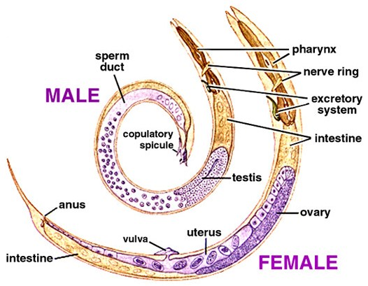
3. Roundworms (Nematodes): Adult and larval roundworms are bisexual, cylindrical worms. They inhabit intestinal and extraintestinal sites.
Genus: Ascaris is a genus of parasitic nematode worms known as the "small intestinal roundworms", which is a type of helminth (parasitic worm). One species, Ascaris lumbricoides, affects humans and causes the disease ascariasis.

Slide 17
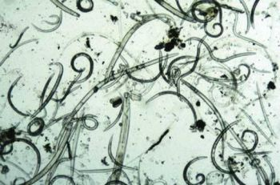
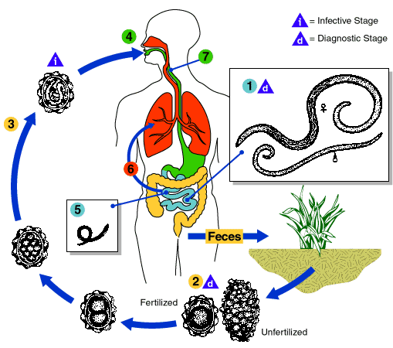
Slide: Ascaris
Life Cycle:

Slide 18
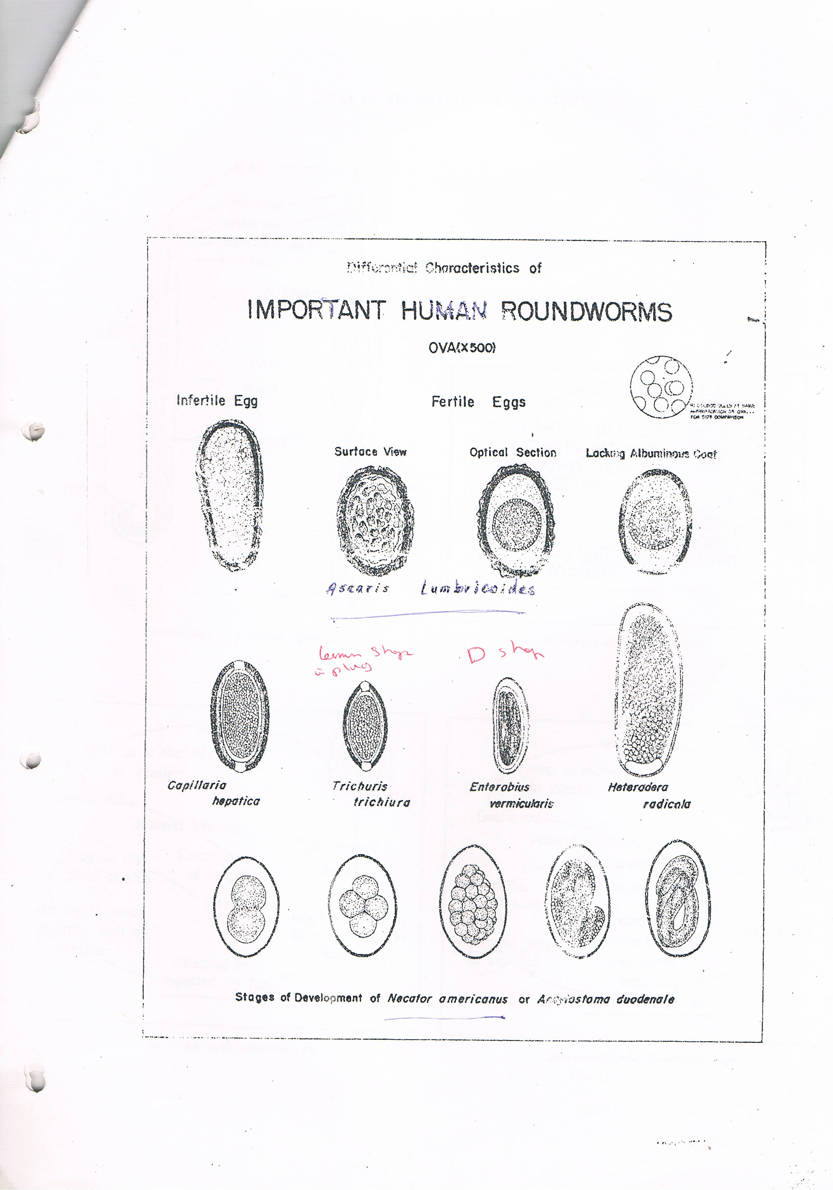
Figure 1: Important human roundworm

Slide 19
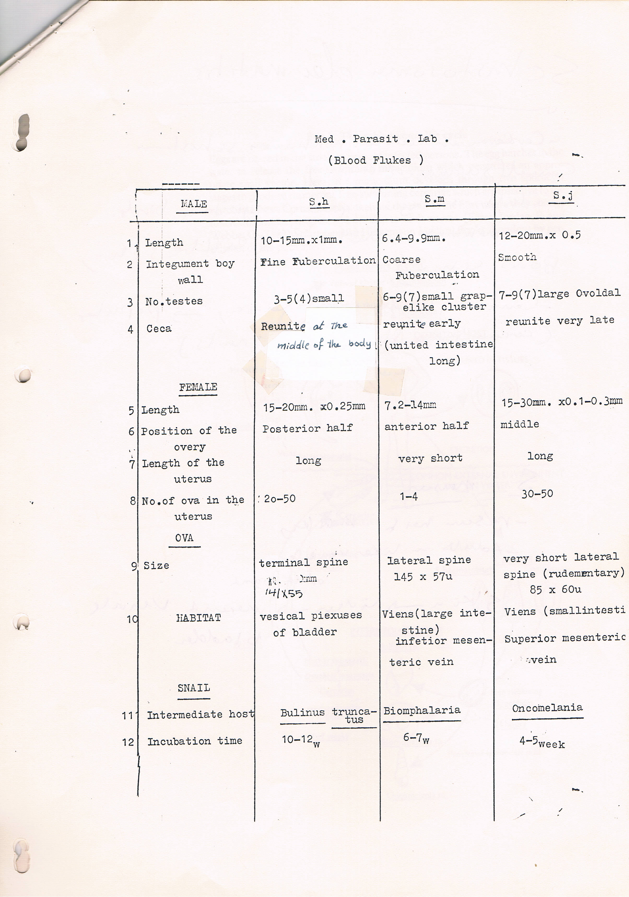
Table 1: Blood Flukes

